Slide 1
Microsoft Word: Basics & Beyond
David Moloney
Jasmine Ryan

Slide 2
Who we are
Jasmine Ryan
UL Student Associate Intern, Enhancing Digital Teaching and Learning (EDTL) project, Centre for Transformative Learning​
David Moloney
UL Project Lead, Enhancing Digital Teaching and Learning (EDTL) project, Centre for Transformative Learning​
COMPANY CULTURE BOOK

Slide 3
How we intend for you to engage with this workshop...
•We would like you to be able to follow along with us and make edits to your downloaded sample file during this workshop.
•If you only have one screen, you can set up the two windows side by side in a split screen set-up.
•Please keep your camera & microphone off during the workshop
•Ask questions in the chat

Slide 4
Introduction & Downloadable Activity File
Create
Edit
Format
Share
Questions
Overview

Slide 5
Introduction
Why Word?
Industry leader in word processing software
Will use it in college/working world

Slide 6
Create
1.Open downloaded ‘Activity File’ and save under a new name
2.Turn on AutoSave

Slide 7
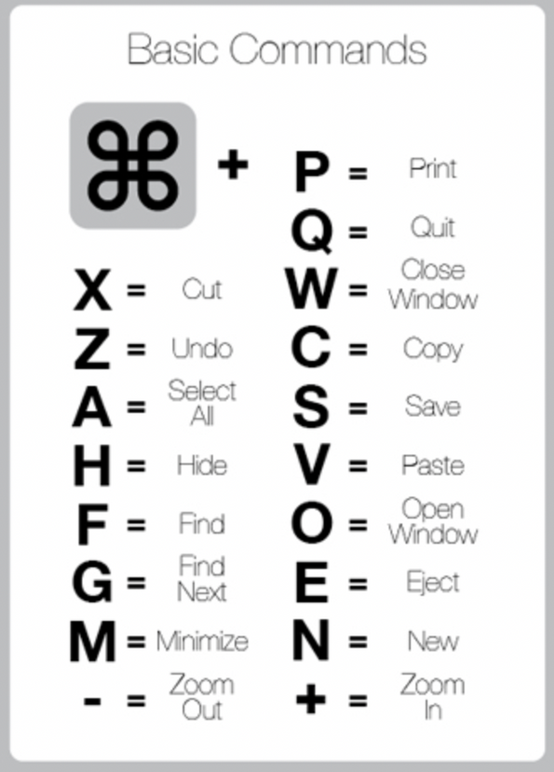
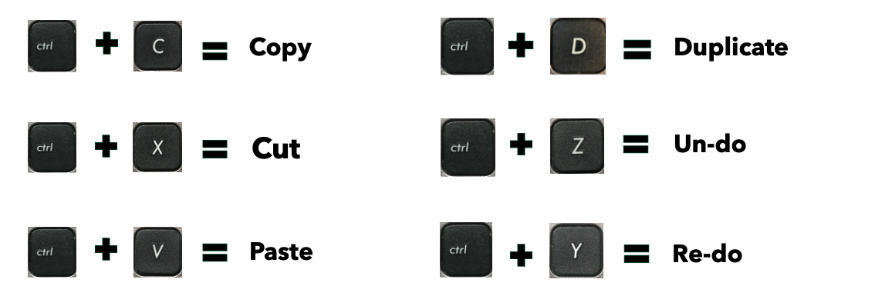
Windows
These keyboard shortcuts make it quicker and easier to edit documents.
Mac OS

Slide 8
Editing the Activity File
Set margins
5. Automatic Table of Contents
6. Page numbers – use page breaks & sections
7. Insert one page landscape / portrait

Slide 9
Formatting
8. Line spacing
9. Headings & styles
10. Inserting a dropped capital
11. Format painter tool
12. Insert a table
13. Insert an image – use cropping & wrapping tools
14. Spelling & grammar check

Slide 10
Share
15. Sharing documents
16. Making comments & notes

Slide 11
Reflection & Questions

Slide 12
Support & Resources
Free resource detailing how to use features in Excel.
https://edu.gcfglobal.org/en/subjects/tech/
• YouTube videos
• Skillshare
• Udemy
• LinkedIn Learning courses

Slide 13
Thank you!

